Slide 1
SOFTWARE ENGINEERING
LECTURE:
HALSTEAD’S SOFTWARE METRICS

Slide 2
Halstead’s Software Science
According to Halstead, “ A Computer program is an implementation of an algorithm considered to be a collection of tokens which can be classified as either operators or operands”.
Halstead’s software science is an analytical technique to measure size, development effort, and development cost of software products.
Halstead defines various indicators to check the complexity of module.
Halstead used a few primitive program parameters to develop the expressions for over all program length, potential minimum volume, actual volume, language level, effort, and development time.

Slide 3
Halstead’s Metrics
Token Count
The size of the vocabulary of a program, which consists of the number of unique tokens used to build a program is defined as:
η = η₁+ η₂
η : vocabulary of a program
η₁ : number of unique operators
η₂ : number of unique operands
where

Slide 4
Halstead’s Metrics
The Size of the program in the terms of the total number of tokens used is
N = N₁+N₂
N : program length
N₁ : total occurrences of operators
N₂ : total occurrences of operands
where

Slide 5
Halstead’s Metrics
Counting rules for C language
Comments are not considered.
Function declarations are not considered.
All the variables and constants are considered operands.
Global variables used in different modules of the same program are counted as multiple occurrences of the same variable.
Local variables with the same name in different functions are counted as unique operands.

Slide 6
Halstead’s Metrics
Counting rules for C language
Functions calls are considered as operators. Function name in a function call statement is considered as an operator, and the arguments of the function call are considered as operands.
All looping statements e.g., do {…} while ( ), while ( ) {…}, for ( ) {…}, all control statements e.g., if ( ) {…}, if ( ) {…} else {…}, etc. are considered as operators.
In control construct switch ( ) {case:…}, switch as well as all the case statements are considered as operators.

Slide 7
Halstead’s Metrics
Counting rules for C language
The reserve words like return, default, continue, break, sizeof, etc., are considered as operators.
All the brackets, commas, and terminators are considered as operators. A pair of parentheses, as well as a block begin block end pair, are considered as single operators. A sequence (statement termination) operator ’;’ is considered as a single operator.
GOTO is counted as an operator and the label is counted as an operand.
Assignment, arithmetic, and logical operators are usually counted as operators. The unary and binary occurrence of “+” and “-” are dealt separately.

Slide 8
Halstead’s Metrics
Counting rules for C language
In the array variables such as “array-name [index]” “array-name” and “index” are considered as operands and [ ] is considered as operator.
In the structure variables such as “struct-name, member-name” or “struct-name -> member-name”, struct-name, member-name are taken as operands and ‘.’, ‘->’ are taken as operators. Same names of member elements in different structure variables are counted as unique operands.
All the hash directive are ignored.

Slide 9
Operators and Operands for the ANSI C language
The following is a suggested list of operators for the ANSI C language:
( [ . , -> * + - ~ ! ++ -- * / % + - << >> < > <= >= != == & ^ | && || = *= /= %= += -= <<= >>= &= ^= |= : ? { ;
CASE DEFAULT IF ELSE SWITCH WHILE DO FOR GOTO
CONTINUE BREAK RETURN and a function name in a function call
Operands are those variables and constants which are being used with operators in expressions. Note that variable names appearing in declarations are not considered as operands.

Slide 10
Examples
Example 1: Consider the expression a = &b;
a, b are the operands and =, & are the operators.
Example 2: Consider the function call statement: func (a, b);
In this, func ‘ ,’, ( ) a n d ; are considered as operators and variables a, b
are treated as operands.

Slide 11
Halstead’s Metrics
Volume
The unit of measurement of volume is the common unit for size “bits”. It is the actual size of a program if a uniform binary encoding for the vocabulary is used.
Program Level
The value of L ranges between zero and one, with L=1 representing a program written at the highest possible level (i.e., with minimum size).
V = N * log₂ η
L = V* / V

Slide 12
Halstead’s Metrics
Program Difficulty
As the volume of an implementation of a program increases, the program level decreases and the difficulty increases. Thus, programming practices such as redundant usage of operands, or the failure to use higher-level control constructs will tend to increase the volume as well as the difficulty.
D= (n1/2) * (N2/n2)
Effort
E = V / L = D * V
The unit of measurement of E is elementary mental discriminations.
D = 1 / L

Slide 13
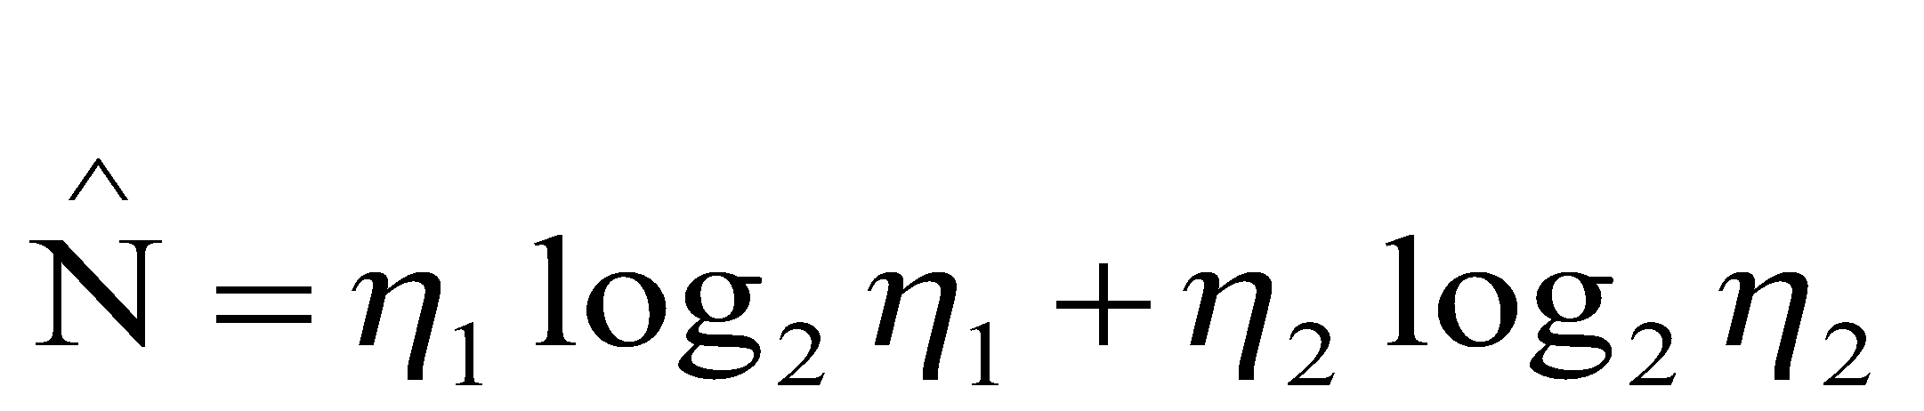
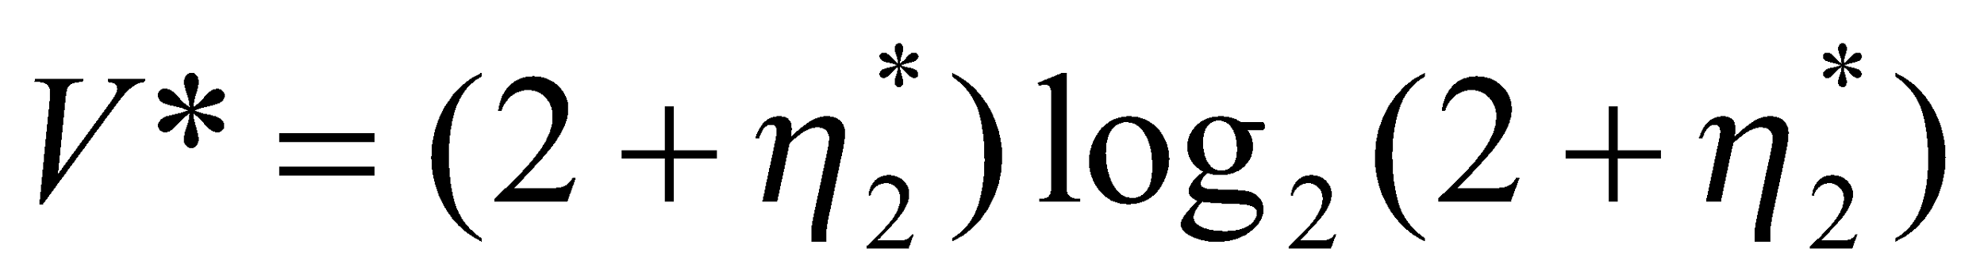
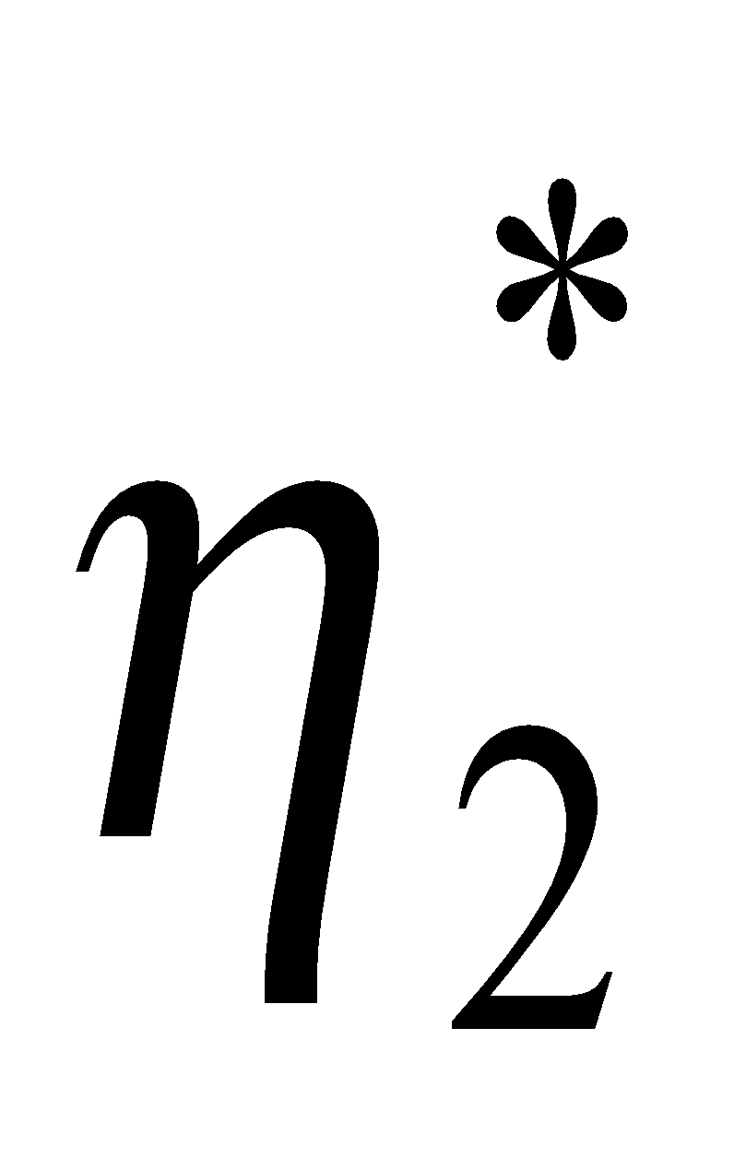
Halstead’s Metrics
Estimated Program Length
Potential Minimum Volume
unique input and output parameters

Slide 14
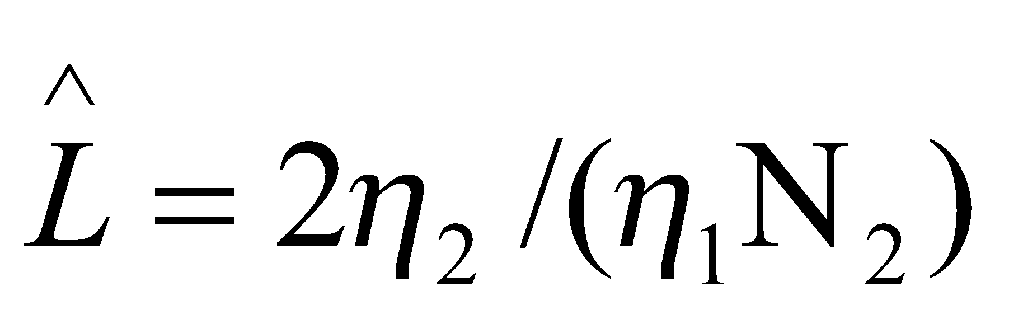
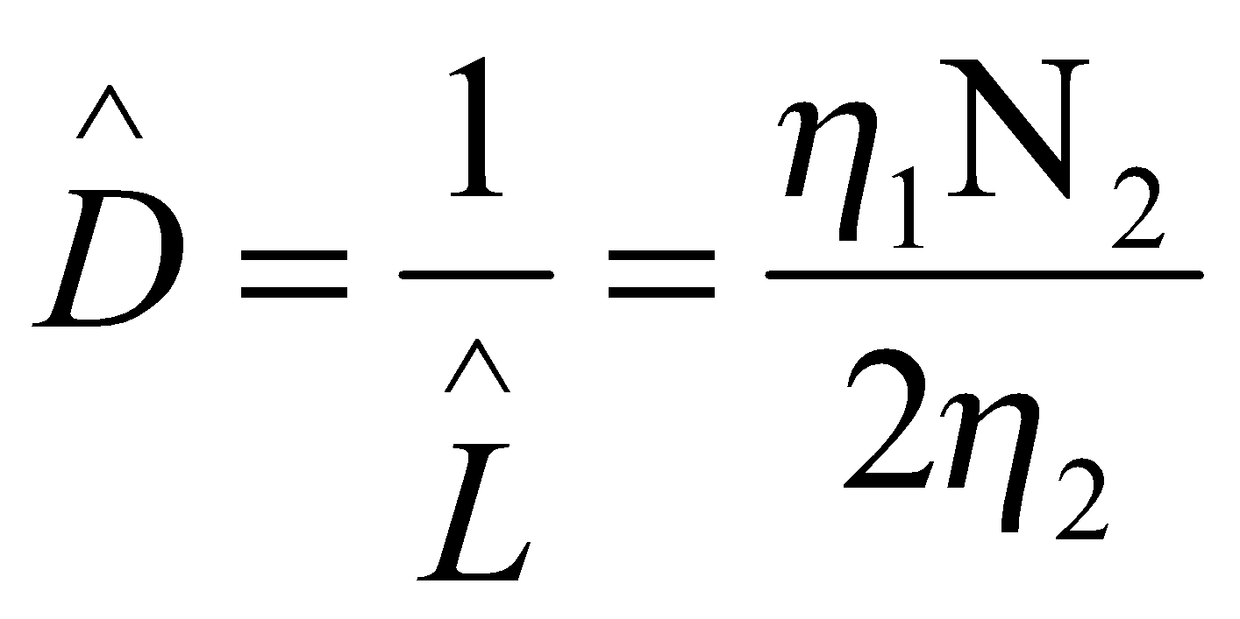
Halstead’s Metrics
Estimated Program Level / Difficulty
Halstead offered an alternate formula that estimate the program level.

Slide 15
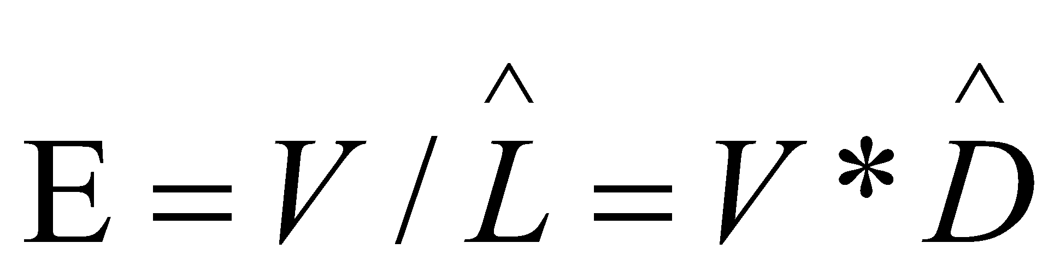
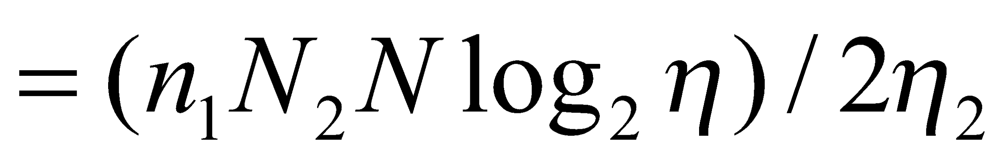
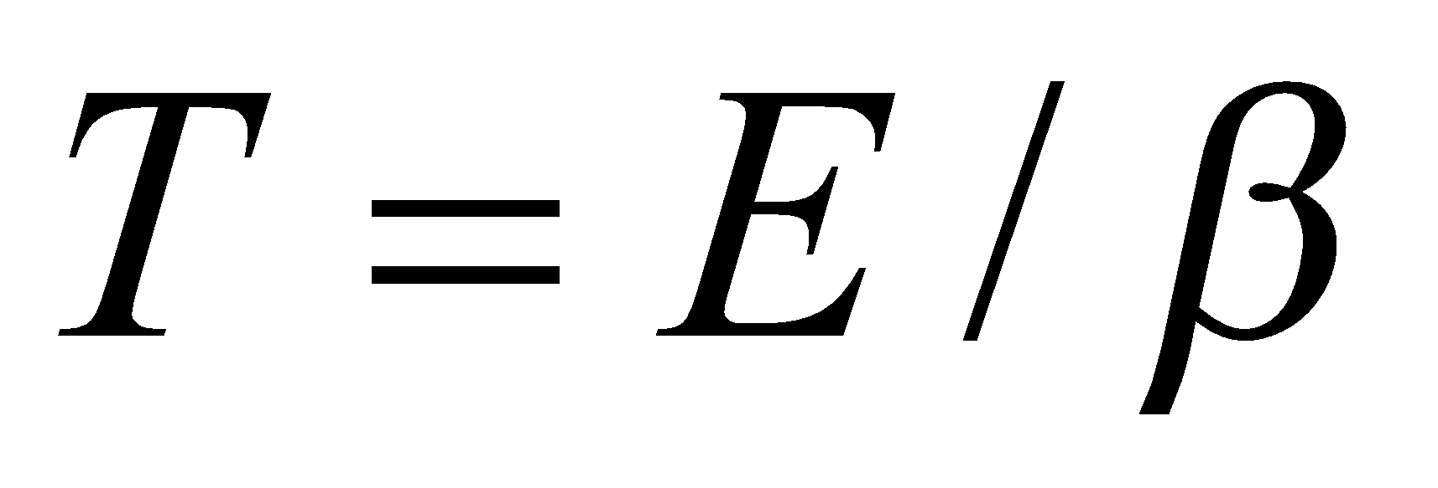
Halstead’s Metrics
Effort and Time
β is normally set to 18 since this seemed to give best results in Halstead’s earliest experiments, which compared the predicted times with observed programming times, including the time for design, coding, and testing.

Slide 16
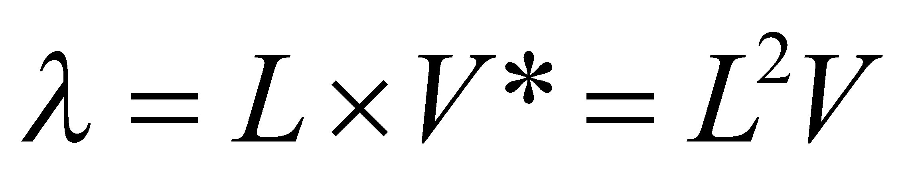
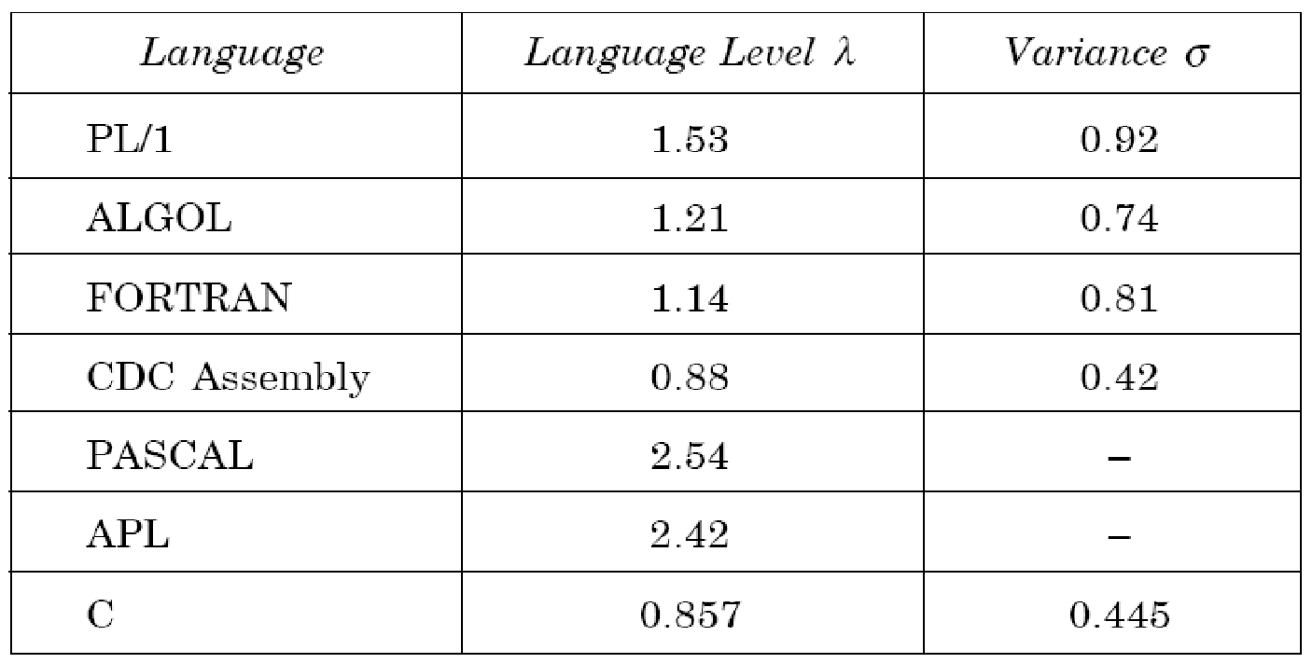
Halstead’s Metrics
Language Level
Using this formula, Halstead and other researchers determined the language level for various languages as shown below.

Slide 17
Exercise
void sort( int *a, int n )
{
int i, j, t;
if ( n <2 )
return;
for( i=0 ; i < n-1; i++)
{
for( j=i+ 1 ; j < n ; j++)
{
if ( a[i] > a[ j] )
{
t = a[ i] ;
a[ i] =a[ j] ;
a[ j] = t;
}}}}

Slide 18
Sol
Operators
void 1
sort – 1
int – 3
* - 1
< - 3
= - 5
> - 1
- - 1
, - 3
; - 9
() - 5
[] – 6
{ } - 4
+ - 1
++ - 2
for – 2
if – 2
return - 1
Operands
0- 1
1- 2
2 – 1
a – 7
t – 3
n – 4
i – 8
j - 7

Slide 19
Sol
Ignore the function definition
Count operators and operands
Total Unique
Operators N1 = 51 n1 = 18
Operands N2 = 33 n2 = 8

Slide 20
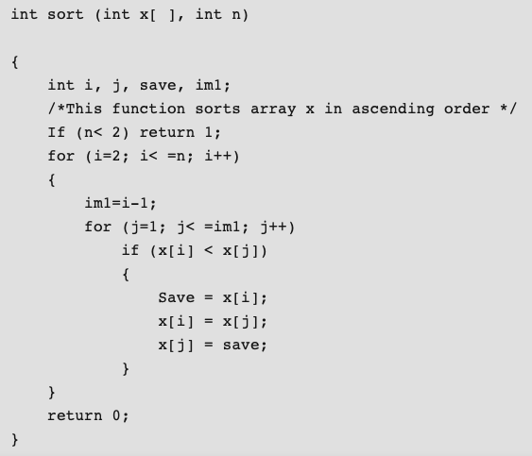

Slide 21
Operators | Occurrences | Operands | Occurrences
int | 4 | x | 7
sort | 1 | n | 3
() | 5 | i | 8
, | 4 | j | 7
[] | 7 | save | 3
if | 2 | im1 | 3
< | 2 | 2 | 2
; | 11 | 1 | 3
for | 2 | 0 | 1
= | 6 | – | –
– | 1 | – | –
<= | 2 | – | –
++ | 2 | – | –
return | 2 | – | –
{} | 3 | – | –
n1=15 | N1=54 | n2=9 | N2=37

Slide 22
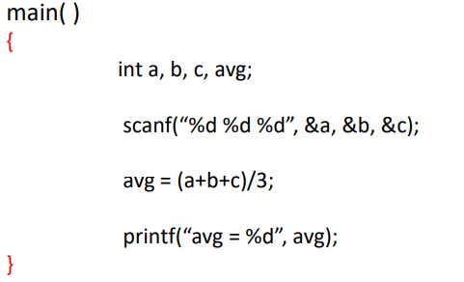
Operators | Occurrences | Operands | Occurrences
main | 1 | a | 3
() | 4 | b | 3
int | 1 | c | 3
, | 7 | avg | 3
; | 4 | 3 | 1
scanf | 1 | “%d%d%d” | 1
& | 3 | “avg = %d” | 1
= | 1
+ | 2
/ | 1
printf | 1
Note: All the characters presents in “” with printf and scanf are counted as single operand.
As shown in the above table last two entries in operands.

Slide 23
McCabe’s Complexity Measures

Slide 24
McCabe’s Complexity Measures
A software metric used to measure the complexity of software
Developed by Thomas McCabe
Described (informally) as the number of simple decision
points + 1
McCabe’s metrics are based on a control flow representation of the program.
A program graph is used to depict control flow.
Nodes represent processing tasks (one or more code statements)
Edges represent control flow between nodes

Slide 25
Flow Graph Notation
While
Sequence
If-then-else
Until

Slide 26
Steps to calculate complexity
Draw the control flow graph of the code
Count the number of edges = E
Count the number of nodes = N
Count the number of connected
components = P
Complexity = E – N + 2P

Slide 27
Example Flow Graph
1
2
3
7
4
5
6

Slide 28
Computing V(G)
Complexity = E – N + 2P
V(G) = 9 – 7 + 2 = 4
V(G) = 3 + 1 = 4
Basis Set
1, 7
1, 2, 6, 1, 7
1, 2, 3, 4, 5, 2, 6, 1, 7
1, 2, 3, 5, 2, 6, 1, 7

Slide 29
Another Example
1
9
2
4
3
5
6
7
8
What is V(G)?

Slide 30
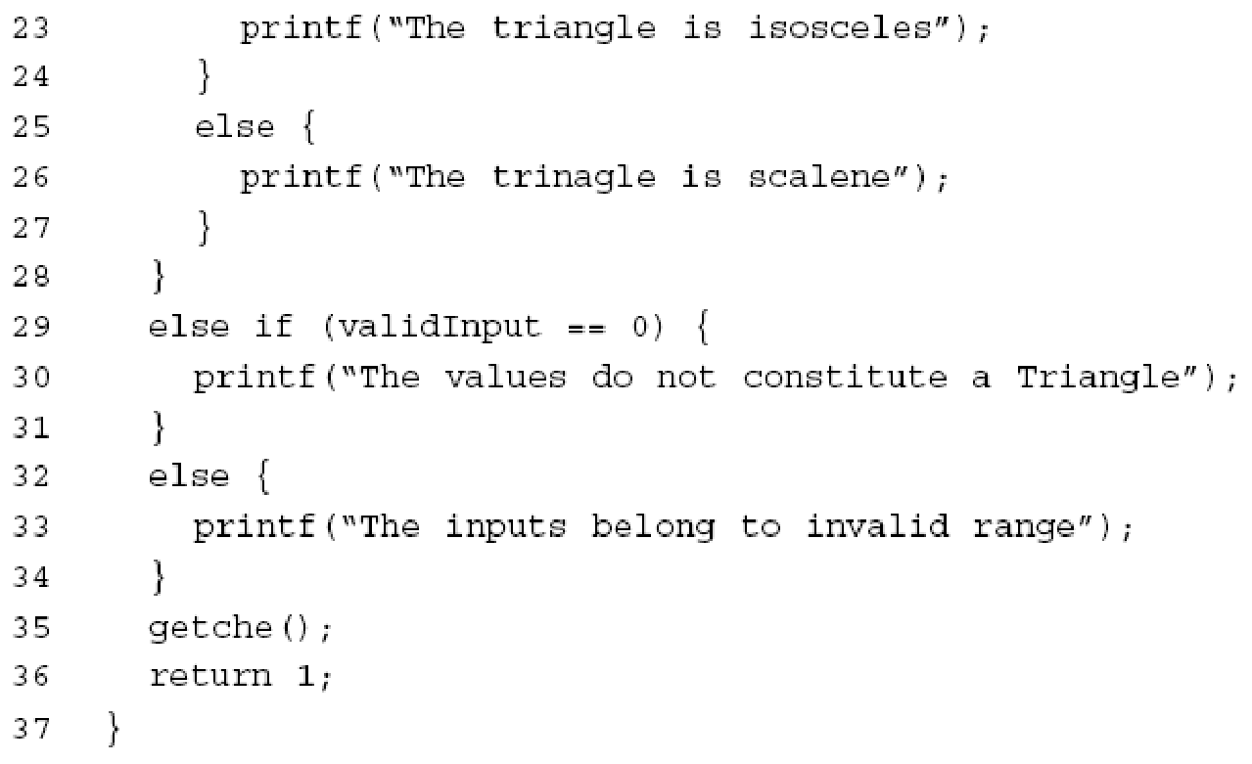
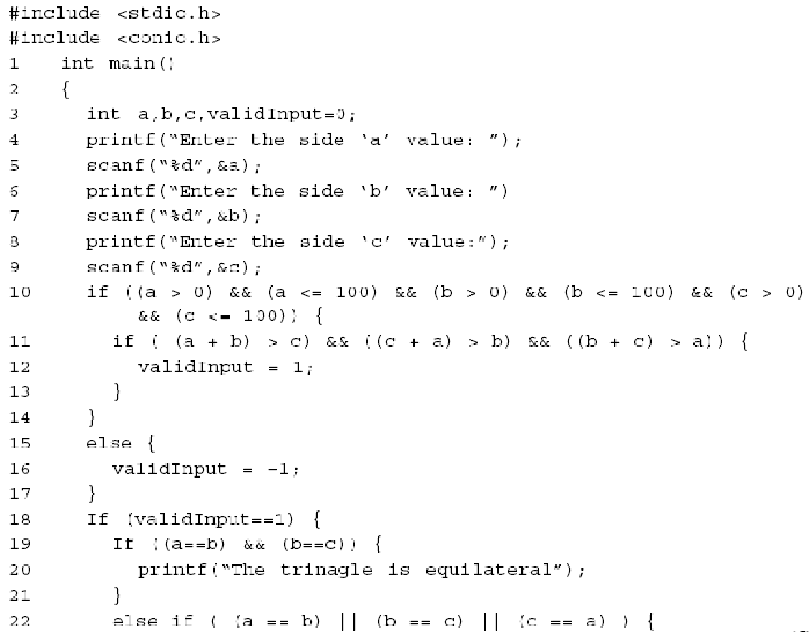
Draw the flow graph
Compute complexity

Slide 31
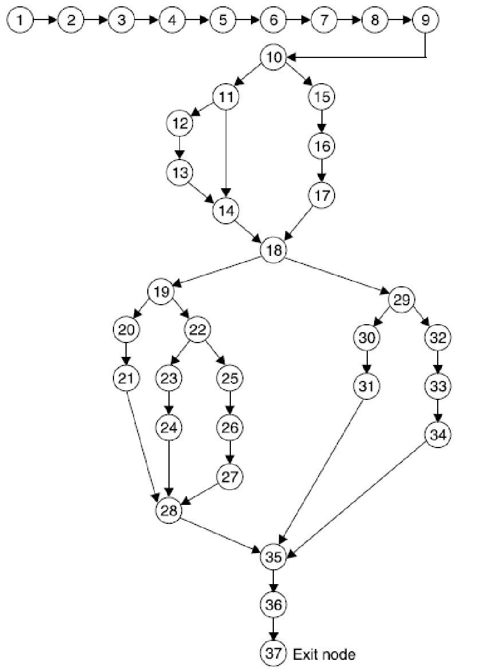

Slide 32
Meaning
V(G) is the number of (enclosed) regions/areas of the planar graph
Number of regions increases with the number of decision paths and loops
A quantitative measure of testing difficulty and an indication of ultimate reliability
Experimental data shows value of V(G) should be no more then 10 - testing is very difficult above this value

